Slide 1





Introduction to Multithreading
Multithreading is a powerful technique used in web server development to improve performance and efficiency. By utilizing multiple threads, web servers can handle multiple requests simultaneously, leading to better responsiveness and a smoother user experience.
by Praneeth Bunny

Slide 2


Improving Responsiveness
Multithreading enables web servers to handle requests from multiple users concurrently, preventing the server from becoming bogged down by a single long-running task.
1
Faster Response Times
By dedicating a separate thread to each request, web servers can process them independently, resulting in faster response times for users.
2
Improved User Experience
Users experience a more seamless and fluid interaction with the website, as their requests are handled promptly without noticeable delays.
3
Enhanced Interactivity
Multithreading allows web applications to maintain responsiveness, even when performing complex calculations or data-intensive operations.

Slide 3
Handling Concurrent Requests
In a web server environment, numerous users may attempt to access the server simultaneously. Multithreading allows the server to handle these requests efficiently by allocating separate threads to each user.
Request Queues
Thread Pool
Concurrency Control
Incoming requests are placed in a queue, waiting to be processed by available threads.
A thread pool is a collection of pre-created threads ready to handle incoming requests.
Mechanisms are in place to ensure that multiple threads accessing shared resources, such as databases or files, do so in a controlled manner, preventing data corruption.
Each thread handles one request at a time, ensuring that each user's data is processed correctly and independently.
This approach avoids the overhead of creating new threads for each request, improving efficiency and resource utilization.

Slide 4

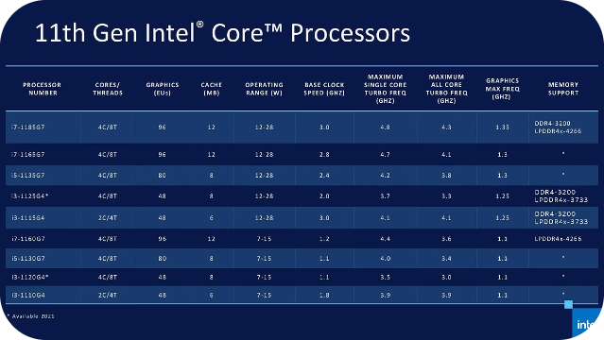
Optimizing CPU Utilization
Web servers often face fluctuating workloads, with periods of high demand followed by lulls. Multithreading enables servers to utilize their CPU resources more effectively by dividing tasks among multiple threads.
Single-Threaded Server
CPU is idle for extended periods when no requests are being processed.
Multithreaded Server
Multiple threads can be used to handle concurrent requests, keeping the CPU busy and maximizing its utilization.

Slide 5





Asynchronous Task Processing
Multithreading allows web servers to handle asynchronous tasks, such as sending emails, file uploads, or background processing, without blocking the main request-handling thread.
User Request
A user submits a request to the web server.
Asynchronous Task
The server creates a separate thread to handle the asynchronous task.
Response to User
The main thread continues to process other requests while the asynchronous task completes in the background.

Slide 6


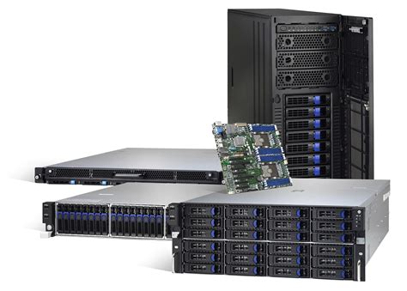


Scaling Web Applications
Multithreading is essential for scaling web applications to handle increasing user traffic and complex workloads. By distributing tasks across multiple threads, web servers can handle a larger number of simultaneous requests without compromising performance.
Increased Throughput
With multithreading, web servers can process more requests per unit of time, leading to higher throughput and improved performance.
Horizontal Scaling
Multithreaded web servers can be deployed across multiple physical machines or virtual instances, allowing for horizontal scaling and improved capacity.
Improved Responsiveness
Even with a high number of concurrent users, multithreading ensures that each user's request is handled promptly, maintaining responsiveness and a smooth user experience.

Slide 7

Challenges and Considerations
While multithreading offers significant benefits, it also introduces certain challenges that need to be carefully addressed. These include thread synchronization, deadlocks, and resource contention.
Synchronization
Deadlocks
Resource Contention
Ensuring that threads access shared resources in a controlled manner to prevent data corruption.
Situations where threads are blocked indefinitely, waiting for resources held by other blocked threads.
Managing the competition between threads for access to shared resources, such as memory or disk I/O.

Slide 8


Conclusion
Multithreading is a fundamental technique in web server development, providing numerous benefits for performance, responsiveness, and scalability. By leveraging the power of multithreading, web servers can deliver a superior user experience and handle the increasing demands of modern web applications.

